Slide 1
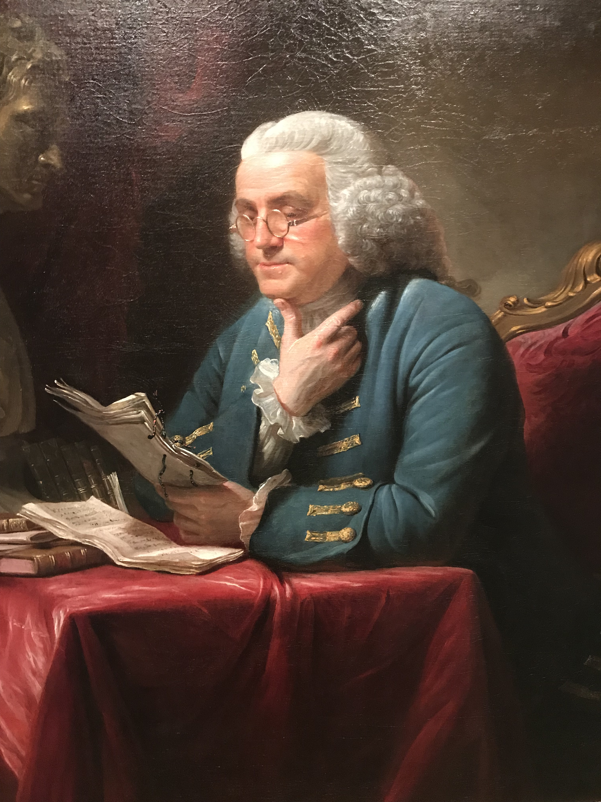
Benjamin Franklin
Scientist, Diplomat, Author—and Role Model?
Mark Canada, Ph.D.
January 22, 2022
Notes:
Good morning and thank you for showing up early on a Saturday morning for this session. I hope you all were “early to bed” before you were “early to rise,” and are feeling healthy, wealthy, and wise.
Benjamin Franklin’s enduring presence is demonstrated in a small way by the simple fact that probably just about everyone in this room recognized those words, and I suspect most of you knew that they came from Franklin. Franklin’s relevance goes well beyond this maxim and the others that are still with us centuries after he published them in his Poor Richard’s Almanack.
As I preparing for this presentation, I got to thinking about Franklin’s relevance today. Some of the other topics covered in Winter College are ripped from contemporary headlines: the #MeToo movement, cyber attacks, constitutional crises, autonomous vehicles, social justice. Others, such as sexuality and sleep, have timeless importance. Some of you might be wondering how stodgy old Benjamin Franklin, who died more than 200 years ago, can compete with such contemporary and timeless topics.

Slide 2
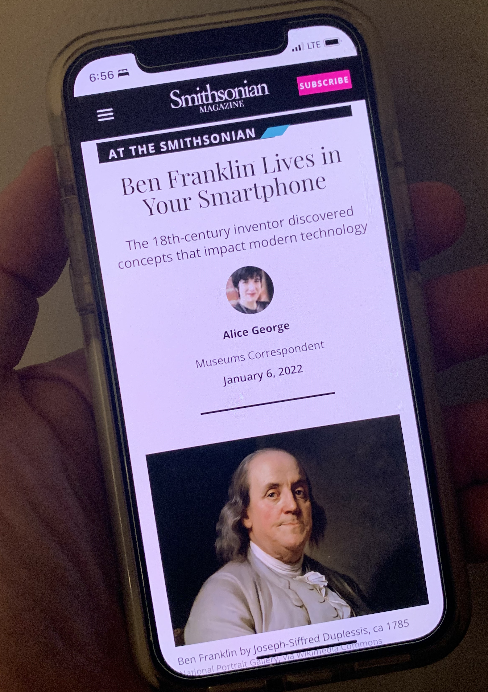
“The Apology from Benjamin Franklin That Predicted the Fight Over Falsehood and Hate on Social Media”
“What Ben Franklin Could Teach Us About Civility and Politics”
”Benjamin Franklin’s Fight Against a Deadly Virus”
“Talking Politics in 2021: Lessons on Humility and Truth-Seeking from Benjamin Franklin”
Notes:
Here’s the thing, though. Like Frederick Douglass and Emily Dickinson, two of my other favorite Americans, Franklin was ahead of his time. In fact, his prescience and lasting relevance are downright eerie. Take some of these topics I just mentioned. Technology, which is central to autonomous vehicles and other dramatic innovations in our world today, was a subject of fascination to Franklin, and he made enduring contributions to it, as we will see. In fact, just this month, the Smithsonian opened an exhibition that celebrates Franklin’s contributions to the central invention of our time: the smartphone. As for constitutions, Franklin was a central figure at our own Constitutional Convention of 1787 and helped ensure that our Constitution would secure passage. Centuries before the #MeToo movement and contemporary campaigns for social justice, Franklin was writing and living in ways that showed a deep appreciation of women, people of color, and the oppressed. I said his relevance was downright eerie. He was also in the middle of-–and, I think, the right side of—two very contemporary topics. Just last year, I wrote two articles about Franklin’s involvement in a controversy surrounding an early form of vaccination and his views on public discourse.
In short, the world has learned a lot from Benjamin Franklin, and there’s still more that we need to learn if we are to achieve our potential as individual humans and a society that values and supports all of its members.
That is actually the overarching purpose of my talk this morning. You will, I hope, learn some interesting, inspiring, and even humorous things about Franklin, but, more important, I hope you will come away with some ideas and strategies that you can use to change your life—literally.

Slide 3
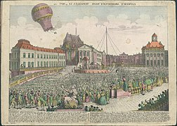
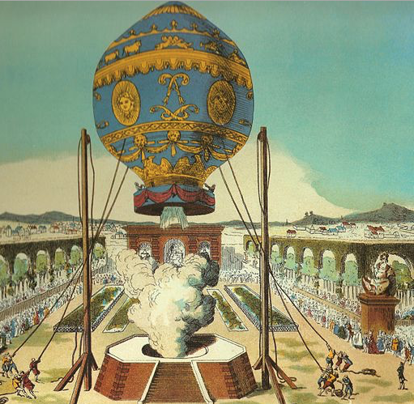
“What is the use of a new-born baby?”
-Benjamin Franklin, 1783
Grafika przedstawiająca lot balonu Montgolfiera ze zwierzętami z 19 września 1783 roku, Creative Commons
Claude-Louis Desrais, image of first hot-air balloon, public domain, Wikimedia Commons
Notes:
Now, with that lofty promise, let’s begin with one of my favorite anecdotes.
Some of you may be familiar with the history of balloon flight. Back in the 1780s, the Montgolfier brothers were experimenting with this new technology in France. As you can imagine, it was something of a sensation, as you can see in this image. At the same time, there likely were at least a few people who wondered whether all of this fuss about giant balloons would amount to anything more than a novelty. As the story goes, the question came up at one of the early flights: someone in the audience questioned the use of this invention. Another individual in the crowd responded with the perfect rejoinder:
What is the use of a new-born baby?"
Well, given the subject of this presentation, you all can guess who delivered the terrific line: Benjamin Franklin.
(As a side note, I have to confess that maybe one reason I so appreciate this line is that, as a teacher of literature, I know many of my students have probably wondered about the relevance of what I am teaching them. “You’re making me read all of these things by Poe and Dickinson and Douglass and Franklin, but when am I ever going to use this?” As this anecdote suggests, however, knowledge is worth pursuing largely because we never know what it will grow up to be, so to speak.)
The line is also, I think, an appropriate way to begin this talk on Benjamin Franklin because it says something about Franklin himself, as well as human potential.
When Franklin was a newborn baby back in January 1706, someone might have rightly wondered what use he would be. After all, he was the 15th child of a man who made soap and candles for a living. Even several years later, when he was a young man, he was not a man of wealth or status or even education--formal education anyway. Unlike Thomas Jefferson and other luminaries of his age, he had not attended college or even much school at all. As a teenager, he left his hometown without telling his family and spent years scraping and shifting, muddling and managing, slowing rising to what he eventually would characterize as "some Degree of Reputation in the World."

Slide 4
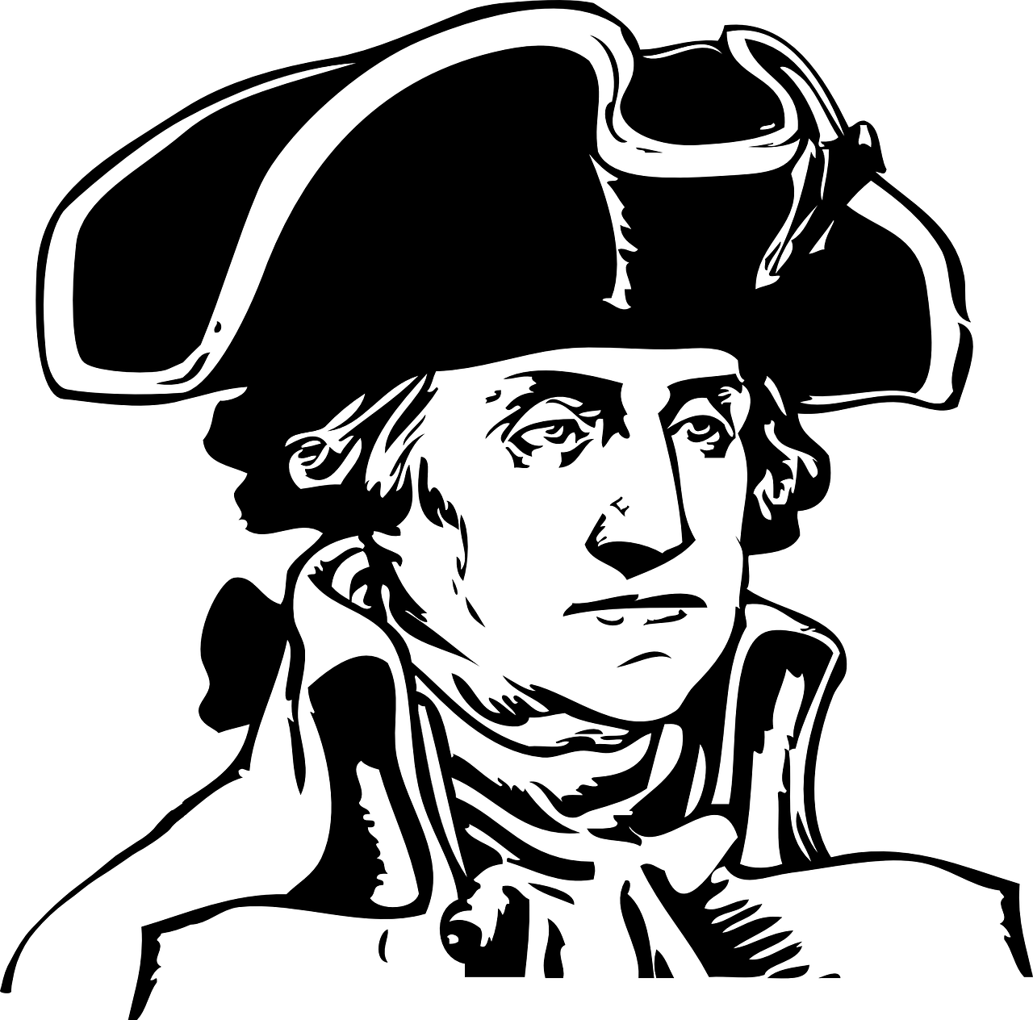
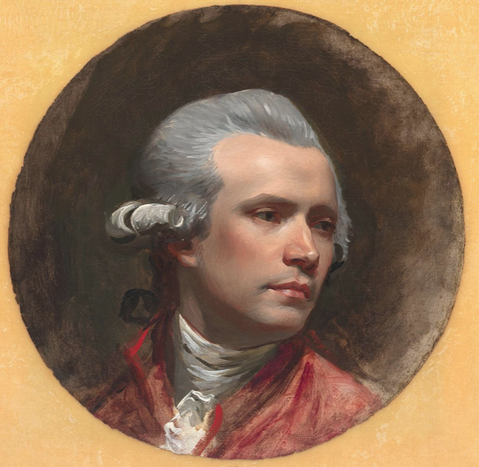
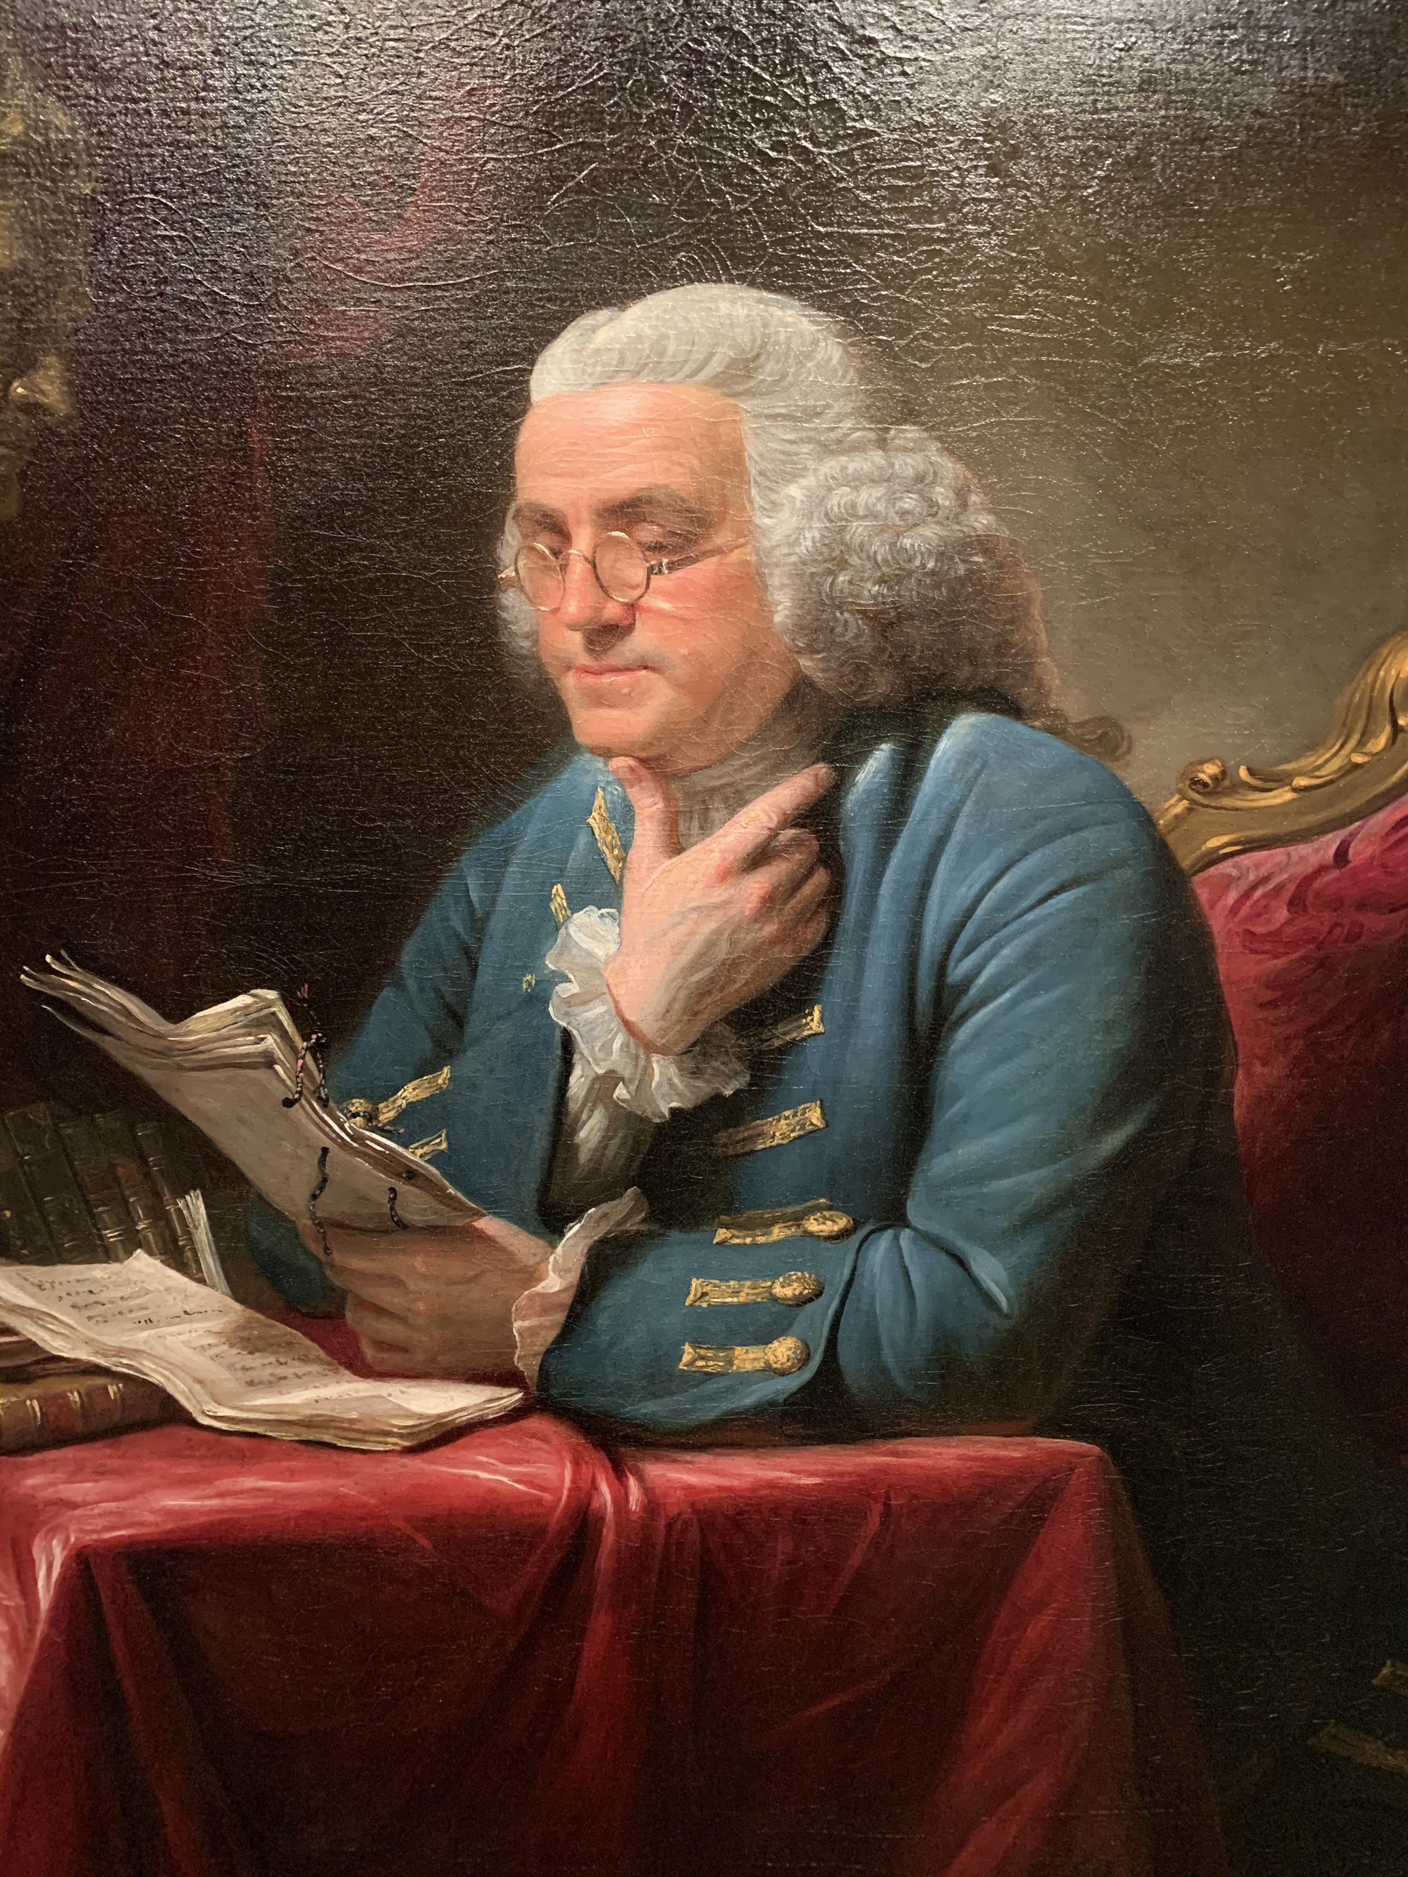
The Greatest?
General
Painter
Scientist
Inventor
Diplomat
Journalist
Author
Philanthropist
Honorable Mentions
Postmaster General
Political Cartoonist
Social Scientist
Abolitionist
Politician
Musician
Swimmer
Raconteur
Notes:
If Franklin was not a man of wealth, he was a man of means. That is, he figured out how to make his way in the world and wound up becoming one of the greatest--perhaps the greatest American in history. Now, that might seem like an extreme statement, but most people don't know the full extent of Franklin's achievements. Let's play a game. Many of us know the leading military figure of the 18th century: George Washington. [Use animations to reveal pictures.]. Some of you may even know the greatest American painter of the 18th century: John Singleton Copley. Who was the greatest American scientist of the era? That's easy: Benjamin Franklin. The greatest inventor? Benjamin Franklin. The greatest diplomat? Benjamin Franklin. The greatest journalist? That would also be Benjamin Franklin. How about the greatest author? Franklin again. (Is this starting to sound like one of those old Parkay commercials?) In his spare time, he was also a postmaster general, a creator of political cartoons, a contributor to the Declaration of Independence, a force behind the adoption of the Constitution, the president of an anti-slavery society, a master swimmer, a legendary raconteur, and a musician who played multiple instruments, including one he invented.

Slide 5
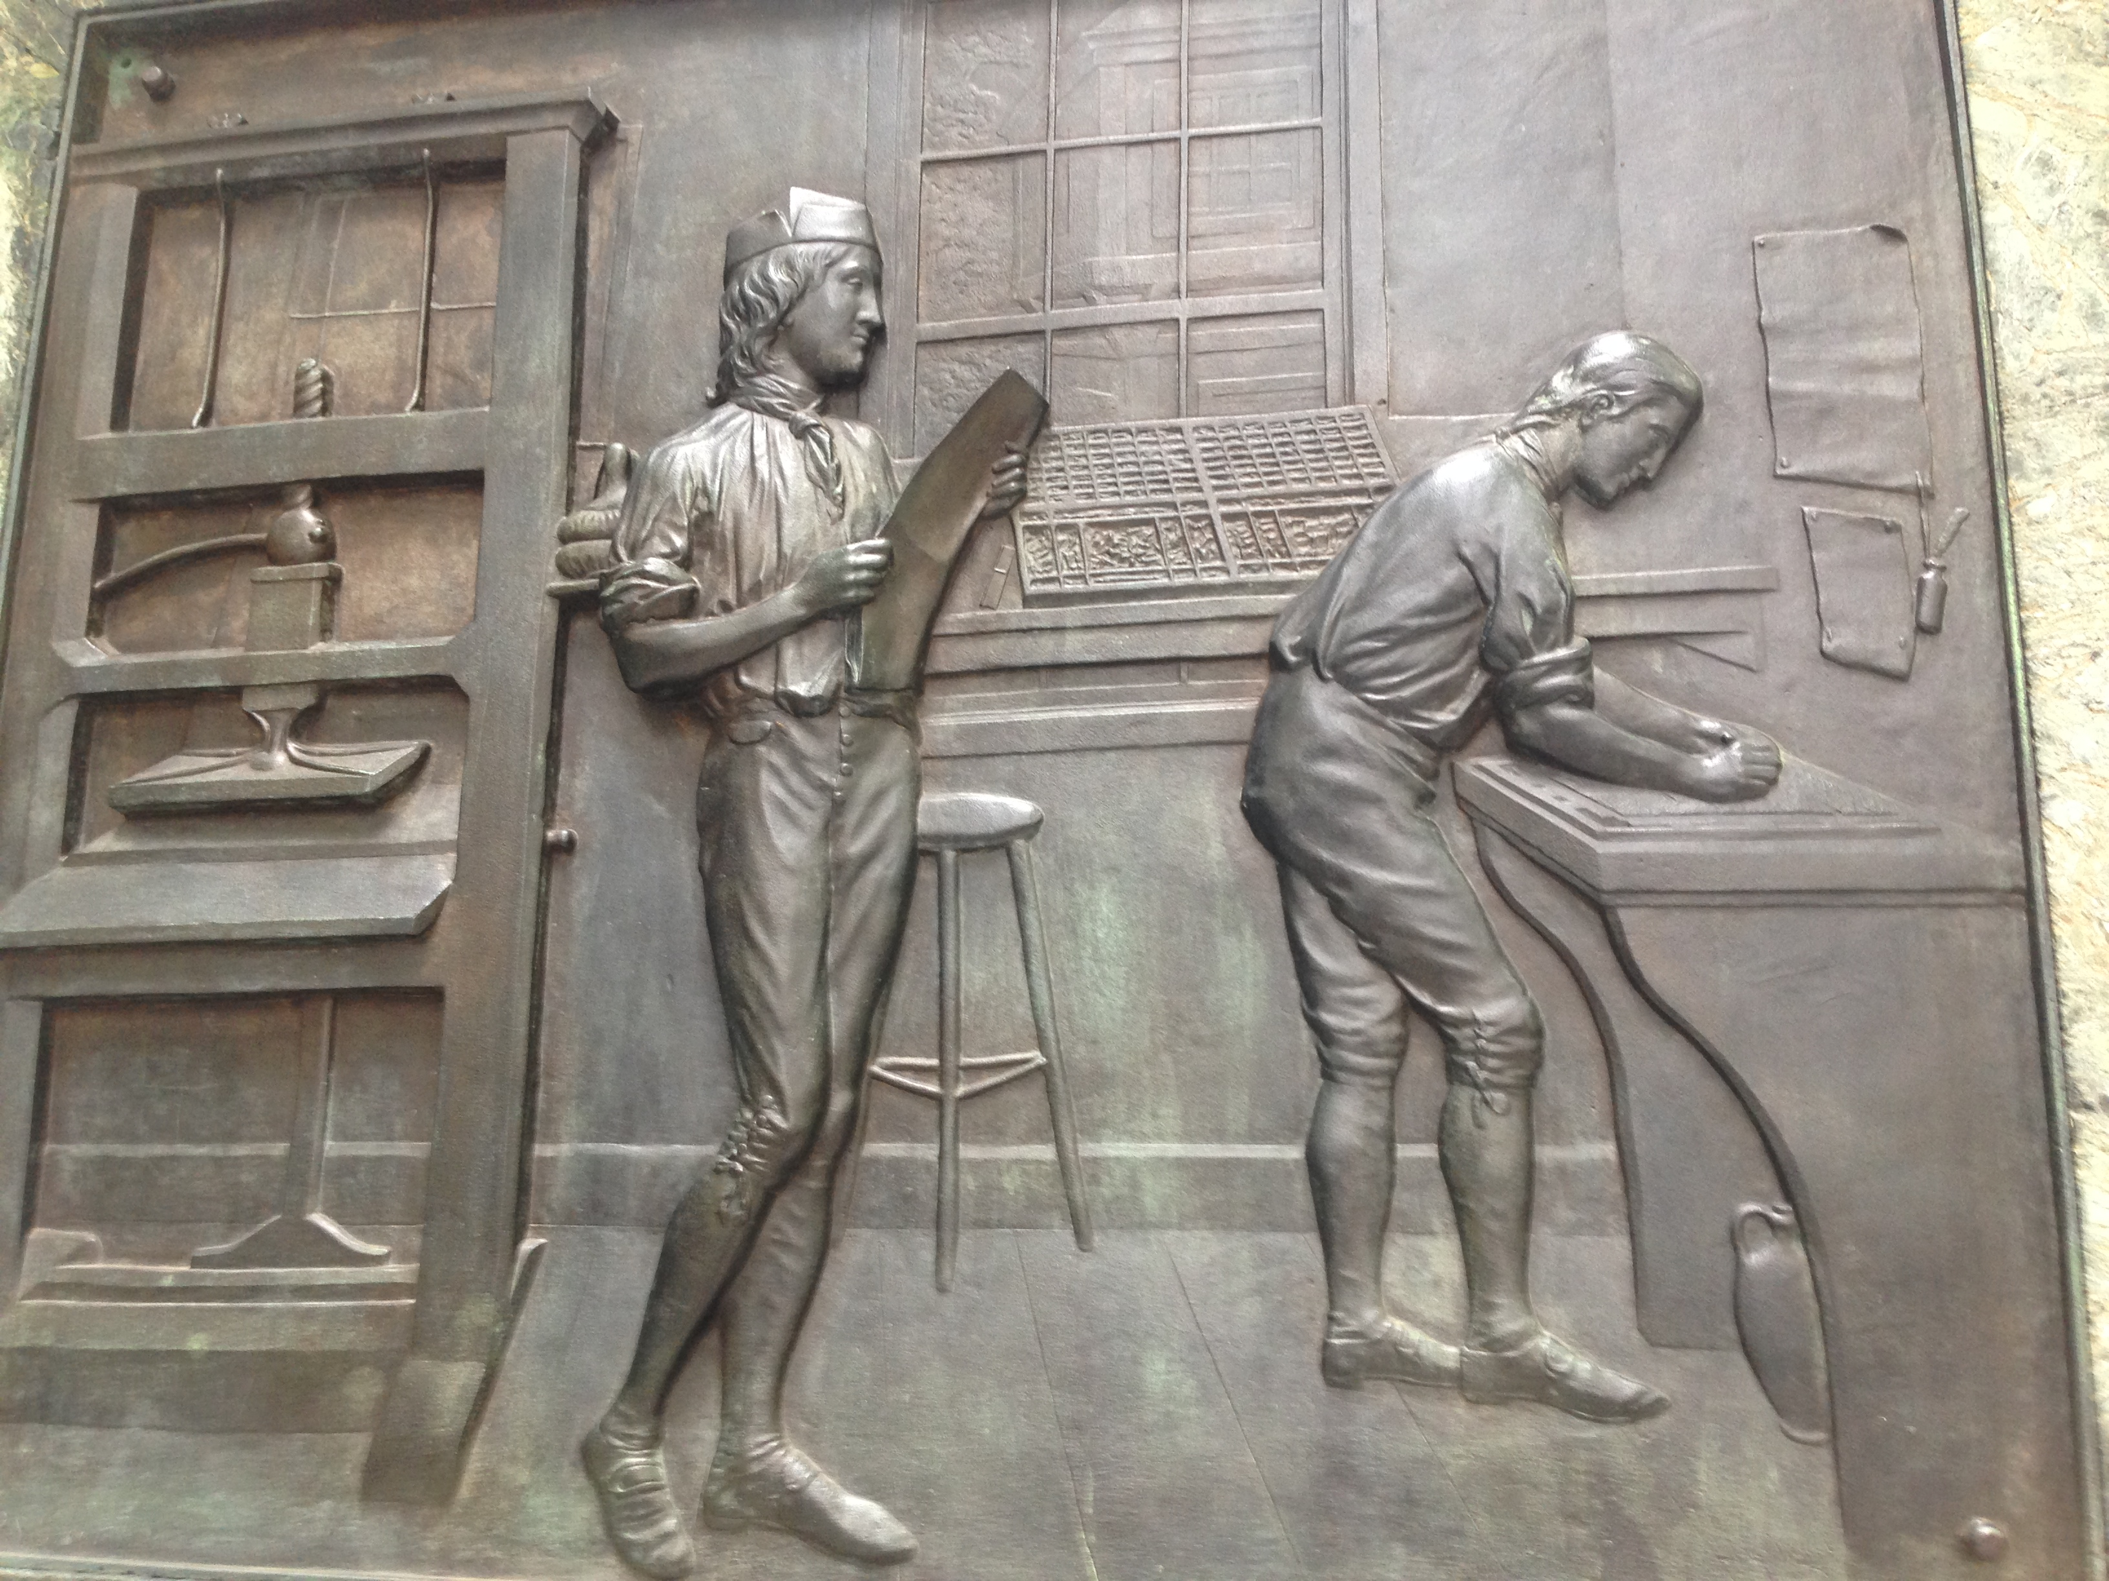

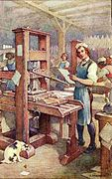
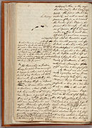
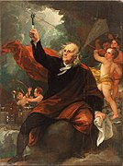
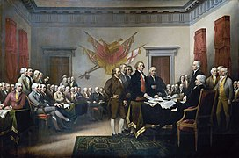
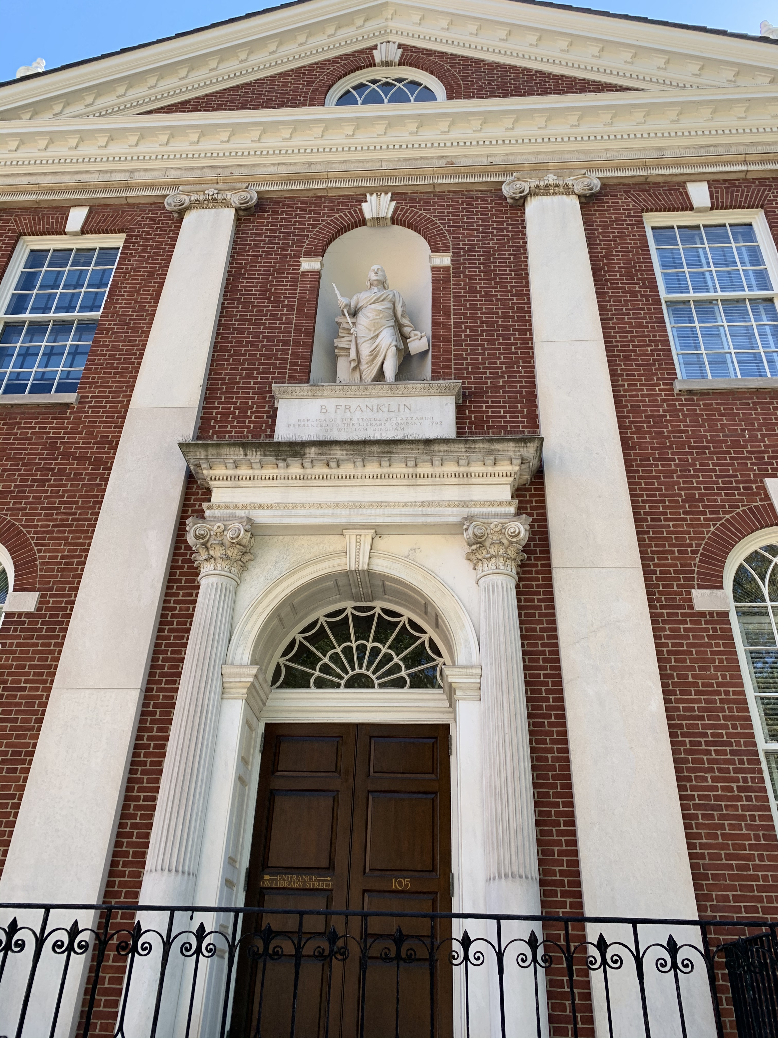
Life
Prodigy
Printer
Author
Philanthropist
Scientist
Statesman
Notes:
For the next 90 minutes or so, we will survey Franklin’s amazing life, touching on several of these accomplishments. Now, as you can imagine, touring this jam-packed life can be not only dazzling, but also dizzying. There’s just so much there—but Franklin made things a little easier on us by living his life in stages. Some of them overlap, but we can roughly say that he went from being a prodigy in Boston to a printer in Philadelphia and London. Along the way, he began his lifelong career as a writer. While in Philadelphia, he became a philanthropist by launching a number of endeavors that would serve his fellow human beings both during and after his life. Retiring from printing in 1748 gave him time to engage in his famous scientific investigations and finally to spend most of his time in public service, becoming a statesman and diplomat and earning the title of “Founding Father.”

Slide 6
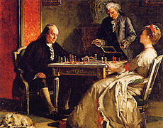
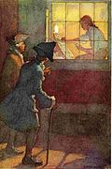
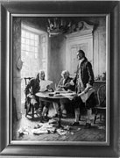
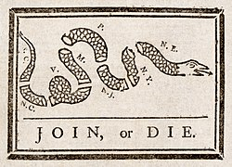
Lessons
Will
Method
Education
Collaboration
Notes:
When someone achieves this kind of success, it's worth examining that person's life and methods. After all, there may be something we can learn from the example. That's especially true of Franklin. As the business executive Thomas Mellon put it . . .
In the case of many great geniuses, it can be difficult to trace the path to their creations and thus to follow their examples. In the world of the arts, which is my area of expertise, writers such as Emily Dickinson and Mozart simply seem immensely gifted with mysterious powers that enable them to craft extraordinary poetry and music that we could never aspire to create. We merely stand in awe of this kind of genius.
Franklin is different, very different. He was a genius, yes, but we can look under the hood and see the mechanics of his genius, even go back in time and see them being constructed, gear by gear. That's because Franklin took a very deliberate approach to cultivating his genius and did us the favor of writing up a fascinating and immensely entertaining account of this process in the form of his autobiography, which he began drafting when he was in his sixties and, alas, never finished because he got busy helping win the American Revolution. (I suppose we can forgive him for that lapse. It's a better excuse than Coleridge had for not finishing his great poem "Kubla Khan." The story goes that Coleridge exploited an opium dream for this poem, but was interrupted by a knock at the door and could not recover all the material and so never finished the poem.)
My goal--and I take it very seriously--is that, when we are finished, there will be at least one takeaway for everyone in this room--one lesson, example, or inspiration that you can use to make your life and your world better. If Franklin were here today, I think, he would be very pleased.

Slide 7
Life
Prodigy
Printer
Author
Philanthropist
Scientist
Statesman
Notes:
For the next 90 minutes or so, we will be taking a look at Franklin's life, legacy, and lessons.
My goal--and I take it very seriously--is that, when we are finished, there will be at least one takeaway for everyone in this room--one lesson, example, or inspiration that you can use to make your life and your world better. If Franklin were here today, I think, he would be very pleased.

Slide 8
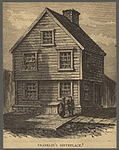
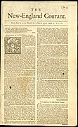
Prodigy (1706-1722)
1706: born on January 17 to Josiah and Abiah Franklin in Boston
1714-1715: attends grammar school
1715-1716: studies arithmetic and writing under George Brownell
1716-1717: works in father's shop
1718: apprenticed to brother James in his print shop
1721: James begins publishing the New-England Courant
“I kept my secret till my small fund of sense for such performances was pretty well exhausted, and then I discovered it, when I began to be considered a little more by my brother's acquaintance, and in a manner that did not quite please him, as he thought, probably with reason, that it tended to make me too vain. And, perhaps, this might be one occasion of the differences that we began to have about this time.”
- Benjamin Franklin, The Autobiography
“. . . I contrived to disguise my hand, and, writing an anonymous paper, I put it in at night under the door of the printing-house. It was found in the morning, and communicated to his writing friends when they call’d in as usual. They read it, commented on it in my hearing, and I had the exquisite pleasure of finding it met with their approbation, and that, in their different guesses at the author, none were named but men of some character among us for learning and ingenuity.”
- Benjamin Franklin, The Autobiography
“At length, a fresh difference arising between my brother and me, I took upon me to assert my freedom, presuming that he would not venture to produce the new indentures. It was not fair in me to take this advantage, and this I therefore reckon one of the first errata of my life; but the unfairness of it weighed little with me, when under the impressions of resentment for the blows his passion too often urged him to bestow upon me, though he was otherwise not an ill-natur'd man: perhaps I was too saucy and provoking.”
- Benjamin Franklin, The Autobiography
“I have . . . a natural Inclination to observe and reprove the Faults of others, at which I have an excellent Faculty. I speak this by Way of Warning to all such whose Offences shall come under my Cognizance, for I never intended to wrap my Talent in a Napkin.”
- Benjamin Franklin, “Silence Dogood,” No. 2
Benjamin Franklin statue base relief, Boston, photograph by Mark Canada
Notes:
I already have given you a little preview of Franklin's beginnings. They were modest.
Even during these early years, in these unpromising surroundings, Franklin showed flashes of brilliance. Here's how he tells the story in his autobiography . . .
"He had some ingenious men among his friends, who amus'd themselves by writing little pieces for this paper, which gain'd it credit and made it more in demand, and these gentlemen often visited us. Hearing their conversations, and their accounts of the approbation their papers were received with, I was excited to try my hand among them; but, being still a boy, and suspecting that my brother would object to printing anything of mine in his paper if he knew it to be mine, I contrived to disguise my hand, and, writing an anonymous paper, I put it in at night under the door of the printing-house. It was found in the morning, and communicated to his writing friends when they call'd in as usual. They read it, commented on it in my hearing, and I had the exquisite pleasure of finding it met with their approbation, and that, in their different guesses at the author, none were named but men of some character among us for learning and ingenuity. I suppose now that I was rather lucky in my judges, and that perhaps they were not really so very good ones as I then esteem'd them."
The "anonymous paper" Franklin refers to here is the first of what became a series known as the "Silence Dogood" papers, more than a dozen satirical essays supposedly written by a highly opinionated widow many years older than Franklin.
Not bad for a 16-year-old, huh? By the way, if any of you are editors like me, you can put away your red pens. Capitalizing nouns was common then (as it still is in German). Spelling conventions, furthermore, were different, and dictionaries were not widely available. (Noah Webster would not produce his first dictionary for another 80 years or so.)
Despite this precocious ability (or perhaps partly because of it), James did not always embrace his star writer.
Some of the excerpts here all come from Franklin's wonderful autobiography, which we will examine more closely in a few minutes, but let me just pause here to draw your attention to a fascinating and delightful aspect of it. Note that reference to "errata." The Latin word erratum (plural: errata) was used in printing circles to refer to a mistake in a printed work. In his autobiography, Franklin imagined his life as a book--natural for someone who so closely identified with his trade--and referred to mistakes he made throughout his life as "Errata." That's a charming little detail, I suppose, but what is really notable is the perspective that allows Franklin to examine his life in this way. Franklin wrote this account of his teen-age years some 50 years later in 1771, when he was 65 years old. He has much more experience, including the experience of raising a son of his own. I fell in love with Franklin's autobiography when I first read it in my 20s, but I appreciate it even more in my 50s because I, too, have more experience. My wife and I have raised two teenagers. Many of you, I suspect, are in similar situations. This kind of perspective not only allows us to commiserate with Franklin, but also to see our own youths in new, more perceptive ways.
To return to our story of Franklin's eventful and auspicious youth, Franklin was through with his brother, but James discouraged his fellow printers from hiring his brother, so Franklin could not depend on finding a position in Boston. Besides, as he explained in his autobiography, ". . . my indiscreet disputations about religion began to make me pointed at with horror by good people as an infidel or atheist." Boston was not a conducive environment for critics of organized religion, as James himself knew all too well.
These circumstances conspired to create one of those historic events that seem to be driven by God or fate. Franklin decided to leave Boston and strike out on his own.

Slide 9
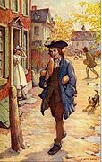
Printer (1723-1748)
“I went on pleasantly, but poor Keimer suffered grievously, tired of the project, long'd for the flesh-pots of Egypt, and order'd a roast pig. He invited me and two women friends to dine with him; but, it being brought too soon upon table, he could not resist the temptation, and ate the whole before we came.”
- Benjamin Franklin, The Autobiography
“He was otherwise an ingenious, sensible man, a pretty good writer, and a good governor for the people. . . . Several of our best laws were of his planning and passed during his administration.”
- Benjamin Franklin, The Autobiography
“But what shall we think of a governor's playing such pitiful tricks, and imposing so grossly on a poor ignorant boy! It was a habit he had acquired. He wish'd to please everybody; and, having little to give, he gave expectations.”
- Benjamin Franklin, The Autobiography
“Early to bed and early to rise, makes a man healthy, wealthy, and wise.”
- Benjamin Franklin, Poor Richard’s Almanack
“I have been the more particular in this description of my journey, and shall be so of my first entry into that city, that you may in your mind compare such unlikely beginnings with the figure I have since made there. . . . I was dirty from my journey; my pockets were stuff’d out with shirts and stockings, and I knew no soul nor where to look for lodging. I was fatigued with traveling, rowing, and want of rest, I was very hungry; and my whole stock of cash consisted of a Dutch dollar, and about a shilling in copper.”
- Benjamin Franklin, The Autobiography
1723: absconds to Philadelphia and finds work at print shop
1724-1725: works at print shops in London
1728: opens print shop in Philadelphia
“I stood out two or three weeks, . . . that, notwithstanding the master's protection, I found myself oblig'd to comply and pay the money, convinc'd of the folly of being on ill terms with those one is to live with continually.”
- Benjamin Franklin, The Autobiography
“He was usually a great glutton, and I promised myself some diversion in half starving him.”
- Benjamin Franklin, The Autobiography
“When the well’s dry we know the worth of water.”
- Benjamin Franklin, Poor Richard’s Almanack
1729: begins publishing newspaper called ThePennsylvania Gazette
1730: enters common-law marriage with Deborah Read
1732: begins publishing Poor Richard’s Almanack
1748: retires from printing
“He that falls in love with himself, will have no Rivals.”
- Benjamin Franklin, Poor Richard’s Almanack
Elmer Boyd Smith, illustration for The Autobiography, public domain, Wikimedia Commons
Notes:
In 1723, without telling his brother or father (or perhaps any other member of his family), he boarded a ship for New York. Finding no work there, he wound up in Philadelphia, where he eventually found work with an eccentric printer named Samuel Keimer.
“Keimer wore his beard at full length, because somewhere in the Mosaic law it is said, "Thou shalt not mar the corners of thy beard." He likewise kept the Seventh day, Sabbath; and these two points were essentials with him. I dislik'd both; but agreed to admit them upon condition of his adopting the doctrine of using no animal food. "I doubt," said he, "my constitution will not bear that." I assur'd him it would, and that he would be the better for it. He was usually a great glutton, and I promised myself some diversion in half starving him.”
“Watts, after some weeks, desiring to have me in the composing-room,^{[43]} I left the pressmen; a new bien venu or sum for drink, being five shillings, was demanded of me by the compositors. I thought it an imposition, as I had paid below; the master thought so too, and forbade my paying it. I stood out two or three weeks, was accordingly considered as an excommunicate, and had so many little pieces of private mischief done me, by mixing my sorts, transposing my pages, breaking my matter, etc., etc., if I were ever so little out of the room, and all ascribed to the chappel ghost, which they said ever haunted those not regularly admitted, that, notwithstanding the master's protection, I found myself oblig'd to comply and pay the money, convinc'd of the folly of being on ill terms with those one is to live with continually.”

Slide 10
Author (1722-1790)
1722: publishes first “Silence Dogood” essay
1729-: writes journalism for Pennsylvania Gazette
1730: “A Witch Trial at Mount Holly”
1747: “The Speech of Miss Polly Baker”
1757: “The Way to Wealth”
1771: begins writing autobiography
1784: resumes autobiography
1778-1780: Bagatelles
1788-1789: writes more of autobiography
1790: leaves autobiography unfinished
“MORTIFIED at the barbarous resolution pronounced by you so positively yesterday evening,—that you would remain single the rest of your life, as a compliment due to the memory of your husband,—I retired to my chamber. Throwing myself upon my bed, I dreamt that I was dead, and was transported to the Elysian Fields.”
- Benjamin Franklin, letter to Madame Helvetius
“I have brought Five fine Children into the World, at the Risque of my Life; I have maintain’d them well by my own Industry, without burthening the Township, and would have done it better, if it had not been for the heavy Charges and Fines I have paid. Can it be a Crime (in the Nature of Things I mean) to add to the Number of the King’s Subjects, in a new Country that really wants People? I own it, I should think it a Praise-worthy, rather than a punishable Action.”
- Benjamin Franklin, “The Speech of Miss Polly Baker”
“. . . I soon became a thorough Deist. My arguments perverted some others, particularly Collins and Ralph; but, each of them having afterwards wrong'd me greatly without the least compunction, and recollecting Keith's conduct towards me (who was another free-thinker), and my own towards Vernon and Miss Read, which at times gave me great trouble, I began to suspect that this doctrine, tho' it might be true, was not very useful.”
- Benjamin Franklin, The Autobiography
“Indignant at this refusal of my Eurydice, I immediately resolved to quit those ungrateful shades, and return to this good world again, to behold the sun and you! Here I am: let us avenge ourselves!”
- Benjamin Franklin, letter to Madame Helvetius
“. . . the said Accused desirous to make their Innocence appear, voluntarily offered to undergo the said Trials, if 2 of the most violent of their Accusers would be tried with them.”
- Benjamin Franklin, “A Witch Trial at Mount Holly”
“When I was young, at times I lacked materials to fill the pages of my gazette, so I amused myself by writing stories.”
- Benjamin Franklin

Slide 11
Philanthropist (1727-1751)
1727: founds Junto
1731: Junto sets up library
1736: forms volunteer fire company
“2. What new story have you lately heard agreeable for telling in conversation?
3. Hath any citizen in your knowledge failed in his business lately, and what have you heard of the cause?
4. Have you lately heard of any citizen’s thriving well, and by what means?”
- “Standing Queries for the Junto”
“Franklin used the Junto as a launching pad for a variety of his public-service ideas.”
- Walter Isaacson, Benjamin Franklin: An American Life
1743: founds American Philosophical Society
1749: proposes academy, which will become University of Pennsylvania
1751: c0-founds Pennsylvania Hospital with new idea of matching funds
Notes:
In 1723, without telling his brother or father (or perhaps any other member of his family), he boarded a ship for New York. Finding no work there, he wound up in Philadelphia, where he eventually found work with an eccentric printer named Samuel Keimer.
“Keimer wore his beard at full length, because somewhere in the Mosaic law it is said, "Thou shalt not mar the corners of thy beard." He likewise kept the Seventh day, Sabbath; and these two points were essentials with him. I dislik'd both; but agreed to admit them upon condition of his adopting the doctrine of using no animal food. "I doubt," said he, "my constitution will not bear that." I assur'd him it would, and that he would be the better for it. He was usually a great glutton, and I promised myself some diversion in half starving him.”
“Watts, after some weeks, desiring to have me in the composing-room,^{[43]} I left the pressmen; a new bien venu or sum for drink, being five shillings, was demanded of me by the compositors. I thought it an imposition, as I had paid below; the master thought so too, and forbade my paying it. I stood out two or three weeks, was accordingly considered as an excommunicate, and had so many little pieces of private mischief done me, by mixing my sorts, transposing my pages, breaking my matter, etc., etc., if I were ever so little out of the room, and all ascribed to the chappel ghost, which they said ever haunted those not regularly admitted, that, notwithstanding the master's protection, I found myself oblig'd to comply and pay the money, convinc'd of the folly of being on ill terms with those one is to live with continually.”

Slide 12
Scientist and Inventor (1740-1775)
c. 1740: invents Pennsylvania fireplace
1746: conducts electrical experiments
“The lightning rod was one of the Enlightenment’s greatest inventions not only for the lives and property it saved, but for its potent symbolism. By subduing nature’s most arrogant power, it raised a defining question of the late eighteenth century: If reason can vanquish thunderbolts, can it also influence morality, social organization, and human behavior?”
- Philip Dray, Stealing God’s Thunder
“He concocted for the first time in history what he called an electrical battery for the storing of electrical charges; he created new English words for the new science—conductor, charge, discharge, condense, armature, electrify, and others; . . . and he came to understand that the plus and minus charges or states of electrification of bodies must occur in exactly even amounts—a quantitative principle that is known today as the law of conservation of charge, a principle fundamental to all science.”
- Gordon Wood, The Americanization of Benjamin Franklin
“A true polymath, he was at home with experts in electricity, meteorology, geology, linguistics, mathematics, literature, philosophy, and politics.”
- H.W. Brands, The First American
“His work on electricity was recognized as ushering in a scientific revolution comparable to those wrought by Newton in the previous century or by Watson and Crick in ours.”
- Dudley Herschbach, chemist
“His name spread widely throughout Europe and not just among the learned few. He became in fact the most famous American in the world.”
- Gordon Wood, The Americanization of Benjamin Franklin
1751: conducts kite experiment, demonstrating that lightning is a form of electricity
1752: installs first lightning rods
“He found electricity a curiosity and left it a science.”
- Cal Van Doren
1761: invents glass armonica
1775: studies Gulf Stream
1784: describes invention of bifocals

Slide 13
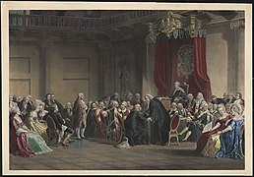
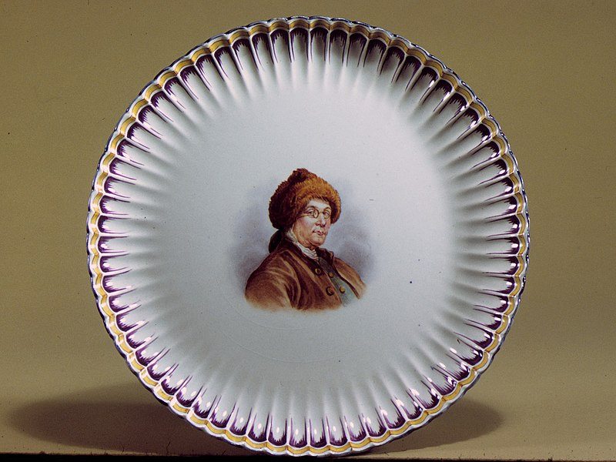
Statesman (1751-1790)
1751-1764: serves in Pennsylvania Assembly
“The real problem Franklin had with Adams was that Adams was a geometrician when it came to foreign policy: There’s the king, we need something from him, let’s just march up and tell him what we need! Franklin understood that you would never get there that way. Instead, you had to waltz, to wander around the floor, sometimes in the opposite direction, in order finally to get to the center of things.”
- Harvey Sicherman, “Benjamin Franklin: American Diplomacy Traditions”
“His face appeared everywhere—on statues and prints and on medallions, snuffboxes, candy boxes, rings, clocks, vases, dishes, handkerchiefs, and pocketknives. Franklin told his daughter that the ‘incredible’ numbers of images spread everywhere ‘have made your father’s face as well known as that of the moon.’”
- Gordon Wood, The Americanization of Benjamin Franklin
“He crossed out, using the heavy backslashes that he often employed, the last three words of Jefferson’s phrase ‘We hold these truths to be sacred and undeniable’ and changed them to the words now enshrined in history: ‘We hold these truths to be self-evident.’”
- Walter Isaacson, Benjamin Franklin: An American Life
“. . . Britain did itself more damage in those two hours than anyone present imagined. By alienating Franklin, the British government showed itself doubly inept: for making an enemy of a friend, and for doing so of the ablest and most respected American alive.”
- H.W. Brands, The First American
1754: proposes Albany Plan of Union
1774: endures philippic in cockpit
“That humble Application be made for an Act of the Parliament of Great Britain, by Virtue of which, one General Government may be formed in America, including all the said Colonies.”
- Benjamin Franklin, Albany Plan of Union
“Being a public official—that was what counted, that was how the community was best served, that was where true greatness and lasting fame could be best achieved.”
-Gordon Wood, The Americanization of Benjamin Franklin
“Compromisers may not make great heroes, but they do make democracies.”
- Walter Isaacson, Benjamin Franklin: An American Life
“the greatest diplomatic victory the United States has ever achieved.”
- Edmund Morgan, historian
1775: drafts Articles of Confederation
1776: assists Jefferson with Declaration of Independence
1778: helps secure French support for American Revolution
1783: negotiates Treaty of Paris
1787: negotiates “great compromise”; calls for unity at Constitutional Convention
1790: calls on Congress to end slavery
Christian Schuessele, Franklin before the Lord’s Council, Whitehall Chapel, London, 1774, public domain, Wikimedia Commons
John Trumbull, Declaration of Independence, public domain, Wikimedia Commons
Notes:
“On January 29 . . . Solicitor General Alexander Wedderburn viciously attacked Franklin, in what Franklin compared to a ‘Bull-baiting.’ For nearly an hour Wedderburn poured abuse on Franklin the likes of which many had never heard before. Much of it was even too scurrilous for the press to publish” (Wood 146).
Being a public official—that was what counted,” Wood explains, “that was how the community was best served, that was where true greatness and lasting fame could be best achieved
“Franklin met with an electrifying welcome—he was the best-known American in the world, largely on account of his scientific work—but no one could say with any authority what exactly he was doing in France,” Schiff says.
“In honor of his great invention, le chapeau paratonnerre, or ‘the lightning rod hat,’ appeared for ladies, complete with trailing chains for ‘grounding,’ as did later the parapluie-paratonnerre, a gentleman’s umbrella” (Dray 141).
“Indeed, the number of Franklin images that were produced is astonishing. His face appeared everywhere—on statues and prints and on medallions, snuffboxes, candy boxes, rings, clocks, vases, dishes, handkerchiefs, and pocketknives. Franklin told his daughter that the ‘incredible’ numbers of images spread everywhere ‘have made your father’s face as well known as that of the moon’” (Wood 177).
“But King Louis XVI grew so irritated at the mounting tide of celebrity and worship that he presented one of the ambassador's most unbridled enthusiasts, Countess Diane de Polignac, with a Sevres porcelain chamber pot elegantly displaying Franklin's effigy on its bottom” (Washington Post).
Franklin wrote—but never sent—a letter to Arthur Lee in response to Lee’s allegations that Franklin was holding back details. The letter reads: “‘It is true I have omitted answering some of your Letters. I do not like to answer angry Letters. I hate Disputes. I am old, cannot have long to live, have much to do and no time for Altercation. If I have often receiv’d and borne your Magisterial Snubbings and Rebukes without Reply, ascribe it to the right Causes, my Concern for the Honour and Success of our Mission, which would be hurt by our Quarrelling, my Love of Peace, my Respect for your good Qualities, and my Pity of your Sick Mind, which is forever Tormenting itself, with its Jealousies, Suspicions and Fancies that others mean you ill, wrong you, or fail in Respect for you. If you do not cure your self of this Temper it will end in Insanity, of which it is the Symptomatick Forerunner, as I have seen in several Instances. God preserve you from so terrible an Evil, and for his sake pray suffer me to live in quiet’” (Dray 147).

Slide 14
Lessons
Will
Method
Education
Collaboration
Notes:
Now that we have surveyed the life and legacy of this amazing human being, let's do some of that "peeking under the hood" to see the gears in operation. When we do, I think you will agree that Franklin's secret was not merely God-given genius--and that it wasn't even a secret.

Slide 15
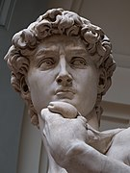
“If people only knew how hard I work to gain my mastery, it wouldn’t seem so wonderful at all.”
-Michelangelo
Michelangelo, David, Creative Commons
Notes:
Do any of you recognize this quotation? The source was not Franklin, but another genius from another era.
I think most people we label "geniuses" would agree with Michelangelo, but we generally only see the finished product--the painting, the sculpture, the poem, the invention, the discovery--not the toil in the studio or the workshop or (to use Newton's famous metaphor) the diligent study over many years of the giants on whose shoulders these geniuses stood.
On some level, I think, Franklin understood this mystery surrounding genius because he made a point of telling the story behind his success. In 1771, when he had some time away from the political work he was doing in England, he took pen in hand and began writing.

Slide 16
“Dear Son,
I have ever had pleasure in obtaining any little anecdotes of my ancestors. . . . Imagining it may be equally agreeable to you to know the circumstances of my life, many of which you are yet unacquainted with, and expecting the enjoyment of a week’s uninterrupted leisure in my present country retirement, I sit down to write them for you. To which I have besides some other inducements. Having emerged from the poverty and obscurity in which I was born and bred, to a state of affluence and some degree of reputation in the world, and having gone so far through life with a considerable share of felicity, the conducing means I made use of, which with the blessing of God so well succeeded, my posterity may like to know, as they may find some of them suitable to their own situations, and therefore fit to be imitated.”
- Benjamin Franklin, The Autobiography
Notes:
This paragraph is the first of what would become Franklin's autobiography. We could spend a productive hour or more just on this paragraph, but, in the interest of time, let me touch on just a few key details.
First, as a professor of literature with a special interest in manuscripts and the creative process, I feel compelled to point out that this is not Franklin's first draft. He actually did a fair amount of revision before he got to this version. Thanks to the Huntington Library, we can see his original manuscript, along with his interpolations and expurgations, online.
Second, we have to say something about the salutation: "Dear Son." I have said that Franklin was writing his autobiography, and he was, but it's not clear whether he intended what he was writing to become a formal book intended for public dissemination. The salutation would seem to indicate something briefer and more intimate. Was Franklin really writing a letter to his son, William? On the one hand, such a letter would make sense. As biographer H. W. Brands observes, Franklin was at this time staying with a family with five daughters.
“Perhaps their mere presence, or their inquiries about what life was like when he was a child, recalled to mind his early years; in any event it was at Twyford that summer that he began writing his memoirs” (Brands 439).
Being in the midst of this family, I would add, could have led him to think of his own family, particularly a son with whom he wished to share the story of his life. On the other hand, as another biographer, Walter Isaacson, contends, a number of details suggest that Franklin really had a broader audience in mind, even from the start.
Slide with four quotations
“The family information that would most interest his son was omitted completely: the identity and description of William’s own mother” (255).
“Nor did Franklin write the letter on regular stationery; instead, he used the left half of large folio sheets, leaving the right half blank for revisions and additions” (Isaacson 255).
“This was obviously directed at an audience beyond that of his son, who was already 40 and the governor of New Jersey” (Isaacson 256).
“There was, however, a subtext directed at him: William had taken on airs since becoming a governor, and he was far more enamored of the aristocracy and establishment than his father. The autobiography would be a reminder of their humble origins and a paean to hard work, thrift, shopkeeping values, and the role of an industrious middle class that resisted rather than emulated the pretensions of the well-born elite” (Isaacson 256).
In any case, the third and most important observation I want to make about this first paragraph has to do with the last, long, complex sentence. [another slide with first paragraph on it]. I can't resist putting on my editor's hat here. In fact, let me just do that right now. [Put on green visor.]. Now, Franklin was a brilliant writer, but he wasn't perfect. Usually, he was a master of participial phrases, but he dangled a giant one here. The main problem, however, is that the sentence is so long and complex that I fear readers begin to teeter before they get to the most important part. I'll spare you all the grammatical breakdown and get to this part, which comes at the end:
". . . my posterity may like to know, as they may find some of them suitable to their own situations, and therefore fit to be imitated."
In short, Franklin was saying that he wished to tell his story because his "posterity" (and perhaps people other than his own family) could pick up a few strategies that were "fit to be imitated.”
Over the past two-and-a-half centuries, untold numbers of readers have found that Franklin's example was indeed "fit to be imitated." By 1900, his autobiography went through 170 editions. One estimate said that the book was requested more than 400 times at a New York City library in a single year (1885).
“John Bach McMaster estimated that in 1885 alone readers at the Cooper Union Library in New York City called for Franklin’s Autobiography more than four hundred times, and for James Parton’s biography nearly a thousand times” (Huang 133).
It's easy to understand its appeal. Long before Horatio Alger gave America the example of Ragged Dick, Franklin was the living embodiment of the American dream, having risen, as he put it, from "poverty and obscurity . . . to a state of affluence and some
degree of reputation in the world."

Slide 17
“I regard the reading of Franklin’s autobiography as the turning point in my life.”
-Thomas Mellon
“For so poor and friendless a boy to be able to become a merchant or a professional man had before seemed an impossibility; but here was Franklin, poorer than myself, who by industry, thrift and frugality had become learned and wise, and elevated to wealth and fame.”
-Thomas Mellon
Notes:
No less than Andrew Carnegie and Thomas Mellon were inspired by Franklin. Mellon said, “I regard the reading of Franklin’s Autobiography as the turning point of my life” (Thomas Mellon, qtd. In Isaacson 481). Mellon said, "The maxims of ‘poor Richard’ exactly suited my sentiments. I read the book again and again, and wondered if I might not do something in the same line by similar means” (Thomas Mellon, qtd. In Isaacson 481).
It's probably no exaggeration to say that, by inspiring and guiding Carnegie, Mellon, and countless less famous Americans, Franklin helped to build this country long after his death. For the next 20 minutes or so, I would like to share a few of his insights that can help all of us in this room to improve our own lives. If you would like to know more, I invite you to listen to my Audible Original Ben Franklin's Lessons in Life, in which I discuss additional lessons and explain all of the lessons in more depth.

Slide 18
“God helps them that help themselves.”
-Benjamin Franklin, Poor Richard’s Almanack
Will
Notes:
Let's begin with a foundational lesson, one that underlies everything else Franklin had to teach us. It is the lesson of free will. Humans have long pondered the degree of control that we have over our lives--that is, how much control we have, as opposed to how much is exerted by supernatural, societal, or natural forces. Although Franklin is sometimes called a philosopher, he was not one to get too wrapped up in this kind of question, the kind that was impossible to answer definitively. When he was an old man, someone asked him about his religious convictions.

Slide 19
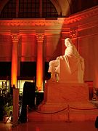
“. . . it is a question I do not dogmatize upon, having never studied it, and think it needless to busy myself with it now, when I expect soon an opportunity of knowing the truth with less trouble.”
-Benjamin Franklin, letter to Ezra Stiles
“He worked in the light.”
-Esmond Wright, Franklin of Philadelphia
Benjamin Franklin National Memorial, public domain, Wikimedia
Notes:
As one biographer has written, Franklin "worked in the light." He was a practical man, one who was interested in inventing devices, coining phrases, crafting policies that would demonstratively make human life better. In the "light" where he worked, he could clearly see that certain actions and decisions led to positive results, while others led to negative results. He also believed that humans could deliberately take actions and make decisions--that is, that they had free will.

Slide 20
“Lucky people build and maintain a strong network of luck.”
-Richard Wiseman, The Luck Factor
“You need to learn that there’s a contingency between your actions and what happens to you.”
-Stephen Maier, neuroscientist
“Although people may differ in every which way—in their initial talents and aptitudes, interests, or temperaments—everyone can change and grow through application and experience.”
-Carol Dweck, Mindset: The New Psychology of Success
Notes:
Ultimately, then, Franklin understood the complexity of human action, recognizing the forces, such as "habit" and "inclination," that act on us, often without our knowledge, but also believed--and, in his own life, demonstrated--that we can overcome these forces through exertion of will.
Modern research has largely validated Franklin’s belief in free will. Research by psychologists Richard Wiseman, Roy Baumeister, Carol Dweck, Angela Duckworth, and others has peeled away much of the mystery around success, showing that free will is a real thing.
All in all, these findings point toward the remarkable benefits of exercising willpower. Without realizing it, people gained a wide array of benefits in areas of their lives that have nothing to do with the specific exercises they were performing

Slide 21
“As I knew, or thought I knew, what was right and wrong, I did not see why I might not always do the one and avoid the other.”
-Benjamin Franklin, The Autobiography
Notes:
Ultimately, then, Franklin understood the complexity of human action, recognizing the forces, such as "habit" and "inclination," that act on us, often without our knowledge, but also believed--and, in his own life, demonstrated--that we can overcome these forces through exertion of will--notably, with help from "method."

Slide 22
“But I soon found I had undertaken a task of more difficulty than I had imagined. While my care was employ'd in guarding against one fault, I was often surprised by another; habit took the advantage of inattention; inclination was sometimes too strong for reason. I concluded, at length, that the mere speculative conviction that it was our interest to be completely virtuous, was not sufficient to prevent our slipping; and that the contrary habits must be broken, and good ones acquired and established, before we can have any dependence on a steady, uniform rectitude of conduct. For this purpose I therefore contrived the following method.”
-Benjamin Franklin, The Autobiography
Notes:
Ultimately, then, Franklin understood the complexity of human action, recognizing the forces, such as "habit" and "inclination," that act on us, often without our knowledge, but also believed--and, in his own life, demonstrated--that we can overcome these forces through exertion of will--notably, with help from "method."

Slide 23
“Will needs a way.”
-Poor Mark
Method
Notes:
Let's take a look at this second lesson from Franklin. As Franklin's discussion of overcoming habit and inclination suggests, he recognized that he needed something more than good intentions to succeed. He needed a "Method." In other words, will needs a way. (It sounds like something Poor Richard should have said, but I coined this one. Maybe all this time with Franklin is rubbing off on me.)

Slide 24
“I determined to give a Week's strict attention to each of the Virtues successively. Thus in the first Week my great Guard was to avoid every the least Offence against Temperance, leaving the other Virtues to their ordinary Chance, only marking every Evening the Faults of the Day. Thus if in the first Week I could keep my first Line marked T clear of Spots, I suppos'd the Habit of that Virtue so much strengthened and its opposite weaken'd, that I might venture extending my Attention to include the next, and for the following Week keep both Lines clear of Spots.”
-Benjamin Franklin, The Autobiography
Notes:
In his autobiography, Franklin shares a list of 13 "Virtues" he sought to master.
As you can see here, he also included "a short Precept" for each one to flesh out its meaning. By the way, he started with only a dozen virtues in his list.
"But a Quaker Friend having kindly inform'd me that I was generally thought proud; that my Pride show'd itslef frquently in Conversation; that I was not content with being in the right when discussing my Point, but was overbearing & rather insolent; of which he convinc'd me by mentioning several Instances; --I determined endeavouring to cure myself if I could of this Vice or Folly among the rest, and I added Humility to my List, giving an extensive Meaning to the Word."
Now he had some specific goals to achieve, but Franklin went further, devising a method for tracking his transgressions. He drew up a grid with a row for each virtue and a column for each day of the week. Here he made "a little black Spot" for every mistake he made. This method provided a way to assess his progress, but, more important, it created a specific goal.

Slide 25
“. . . like him who, having a garden to weed, does not attempt to eradicate all the bad herbs at once, which would exceed his reach and his strength, but works on one of the beds at a time . . . so I should have, I hoped, the encouraging pleasure of seeing on my pages the progress I made in virtue, by clearing successively my lines of their spots, till . . . I should be happy in viewing a clean book, after a thirteen weeks' daily examination.”
-Benjamin Franklin, The Autobiography
“When people have to make a big change in their lives, their efforts are undermined if they are trying to make other changes as well.”
-Roy Baumeister and John Tierney, Willpower
Notes:
As one biographer has written, Franklin "worked in the light." He was a practical man, one who was interested in inventing devices, coining phrases, crafting policies that would demonstratively make human life better. In the "light" where he worked, he could clearly see that certain actions and decisions led to positive results, while others led to negative results. He also believed that humans could deliberately take actions and make decisions--that is, that they had free will.

Slide 26
“Begin with the end in mind.”
-Stephen R. Covey, The Seven Habits of Highly Effective People
“You’ve got to be very careful if you don’t know where you are going, because you might not get there.”
-Yogi Berra, Hall of Fame catcher and sage
Notes:
In this method, Franklin was way ahead of his time. Long before anyone was talking about setting "SMART goals," Franklin was setting specific, measurable, achievable, relevant, and timely goals, and he was tracking his progress. Modern habit guru James Clear cites Franklin's method as an example of an effective way of promoting progress through tracking. Furthermore, if psychologist and willpower expert Roy Baumeister is correct that using willpower strengthens it, just as exercising a muscle makes it stronger, Franklin was building a world-class willpower by working on multiple areas where he wished to improve.

Slide 27
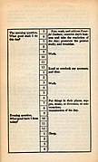
“The precept of Order requiring that every part of my business should have its allotted time, one page in my little book contain’d the following scheme of employment for the twenty-four hours of a natural day.”
-Benjamin Franklin, The Autobiography
“precommitment”: “. . .the essence of this strategy is to lock yourself into a virtuous path.”
- Roy Baumeister and John Tierney, Willpower
Benjamin Franklin’s daily schedule, public domain, Wikimedia Commons

Slide 28
“Genius without education is like silver in the mine.”
-Poor Richard
Education
“.”
- Benjamin Franklin, The Autobiography

Slide 29
“As to their STUDIES, it would be well if they could be taught every Thing that is useful, and every Thing that is ornamental: but Art is long, and their Time is short. It is therefore propos’d that they learn those Things that are likely to be most useful and most ornamental. Regard being handed to the several Professions for which they are intended.”
-Benjamin Franklin, Proposals Relating to the Education of Youth in Pennsylvania
Notes:
For someone who had only a few years of formal schooling, Franklin had what might seem a surprising enthusiasm for education. As we have seen, he founded the Pennsylvania Academy, which later became the University of Pennsylvania. What I didn't mention earlier is that he also wrote an essay in which he laid out the components of a curriculum. In "Proposals Relating to the Education of Youth in Pennsylvania," he called for an education in arithmetic, arithmetic, accounting, geometry, astronomy, English grammar, composition, history, morality, gardening, mechanics, and more. (I'm happy to see English grammar here.). He wrote:

Slide 30
“About this time I met with an odd volume of the Spectator. . . . I thought the writing excellent, and wished, if possible, to imitate it. With this view I took some of the papers, and, making short hints of the sentiment in each sentence, laid them by a few days, and then, without looking at the book, try’d to compleat the papers again, by expressing each hinted sentiment at length, and as fully as it had been expressed before, in any suitable words that should come to hand. Then I compared my Spectator with the original, discovered some of my faults, and corrected them.”
-Benjamin Franklin, The Autobiography
Notes:
What is more important for our purposes here is that Franklin took great care in educating himself. Decades before he wrote this proposal, he was reading and teaching himself to write effectively. His discussion of the latter is particularly interesting:
". . . . I also sometimes jumbled my collections of hints into confusion, and after some weeks endeavored to reduce them into the best order, before I began to form the full sentences and compleat the paper. This was to teach me method in the arrangement of thoughts. By comparing my work afterwards with the original, I discovered many faults and amended them; but I sometimes had the pleasure of fancying that, in certain particulars of small import, I had been lucky enough to improve the method of the language, and this encouraged me to think I might possibly in time come to be a tolerable English writer, of which I was extremely ambitious."

Slide 31
“I also sometimes jumbled my collections of hints into confusion, and after some weeks endeavored to reduce them into the best order, before I began to form the full sentences and compleat the paper. This was to teach me method in the arrangement of thoughts. By comparing my work afterwards with the original, I discovered many faults and amended them; but I sometimes had the pleasure of fancying that, in certain particulars of small import, I had been lucky enough to improve the method of the language, and this encouraged me to think I might possibly in time come to be a tolerable English writer, of which I was extremely ambitious.”
-Benjamin Franklin, The Autobiography
Notes:
What is more important for our purposes here is that Franklin took great care in educating himself. Decades before he wrote this proposal, he was reading and teaching himself to write effectively. His discussion of the latter is particularly interesting:
". . . . I also sometimes jumbled my collections of hints into confusion, and after some weeks endeavored to reduce them into the best order, before I began to form the full sentences and compleat the paper. This was to teach me method in the arrangement of thoughts. By comparing my work afterwards with the original, I discovered many faults and amended them; but I sometimes had the pleasure of fancying that, in certain particulars of small import, I had been lucky enough to improve the method of the language, and this encouraged me to think I might possibly in time come to be a tolerable English writer, of which I was extremely ambitious.”
Now, I'll admit to being a little biased here, but I would contend that Franklin's mastery of writing--and communication in general--is one of the most important keys to his success, second only to his enthusiasm for free will. As I have noted, he became the greatest writer of the 18th century, but writing was rarely if ever an end in itself for Franklin. Writing was, rather, a means to various ends, as was oral communication. The ability to choose and organize his words helped him thrive in his business, achieve a reputation, and persuade others to act, notably in the Constitutional Convention, where he successfully proposed a compromise on representation in Congress and made a memorable case for approving the Constitution at a time when it was not certain it would pass muster with the others members of the convention.

Slide 32
“On the whole, Sir, I can not help expressing a wish that every member of the Convention who may still have objections to it, would with me, on this occasion doubt a little of his own infallibility, and to make manifest our unanimity, put his name to this instrument.”
-Benjamin Franklin, speech written for the Constitutional Convention of 1787
“For having lived long, I have experienced many instances of being obliged by better information, or fuller consideration, to change opinions even on important subjects, which I once thought right, but found to be otherwise. It is therefore that the older I grow, the more apt I am to doubt my own judgment, and to pay more respect to the judgment of others.”
-Benjamin Franklin, speech written for the Constitutional Convention of 1787
Notes:
Here is a passage from a speech that Franklin wrote for someone else to deliver near the end of the convention:
The principle underlying these words was even more important than the words themselves. As his words here indicate, Franklin was willing to consider the fact that he might be wrong about something. That might seem like a small thing, but consider how much of the conflict in this country and elsewhere is the result of people's confidence--even certainty--in their own opinions. If anyone had a right to such confidence, it was Franklin--unquestionably one of the most brilliant minds of his time--yet Franklin sought to remain open-minded and intellectually humble. In this same speech, he wrote:
Here, then, is an important component of Franklin's scheme of education. Thanks to his efforts to educate himself, particularly through reading, he knew a lot--but he also remained open to new information and ideas.

Slide 33
“He that drinks his cider alone, let him catch his horse alone.”
-Poor Richard
Collaboration
Notes:
Not only can one have it both ways, elevating oneself while elevating others, but—and here’s the key—each accentuates the other. In other words, empowering oneself serves the community, and empowering the community serves oneself. It’s not a zero-sum game. Rather, it’s a compounding game: when I improve myself, I increase my ability to help you (and others), and when I help you, I equip you to help me (and others). We all get better together. That’s a powerful message, one I wish were more pervasive and influential today.

Slide 34
“. . . I had form’d most of my ingenious Acquaintance into a Club, for mutual Improvement . . .”
-Benjamin Franklin, The Autobiography
“What he envisioned was a more sophisticated and geographically inclusive version of the Junto: a discussion group that brought together inquiring minds from across the continent rather than across the city.”
-H.W. Brands, The First American
American Philosophical Society, photograph by Mark Canada
Notes:
Here is a passage from a speech that Franklin wrote for someone else to deliver near the end of the convention:

Slide 35
“Beyond our own social horizons, friends of friends of friends can start chain reactions that eventually reach us, like waves from distant lands that wash up on our shores.”
-Nicholas Christakis and James Fowler, Connected
“The good men may do separately is small compared with what they may do collectively.”
-Benjamin Franklin
Notes:
James Surowiecki has observed. In his book The Wisdom of Crowds, Surowiecki explains, “. . . under the right circumstances, groups are remarkably intelligent, and are often smarter than the smartest people in them.” Surowiecki, The Wisdom of Crowds, xiii.
Noting that sociologists have suggested that the average person has about 300 relatively close acquaintances, Wiseman points out that each of us then typically is just once removed from some 90,000 people. That’s a lot of potential professional, romantic, and other opportunities.

Slide 36
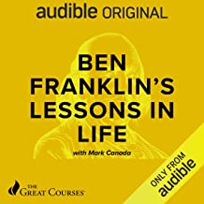
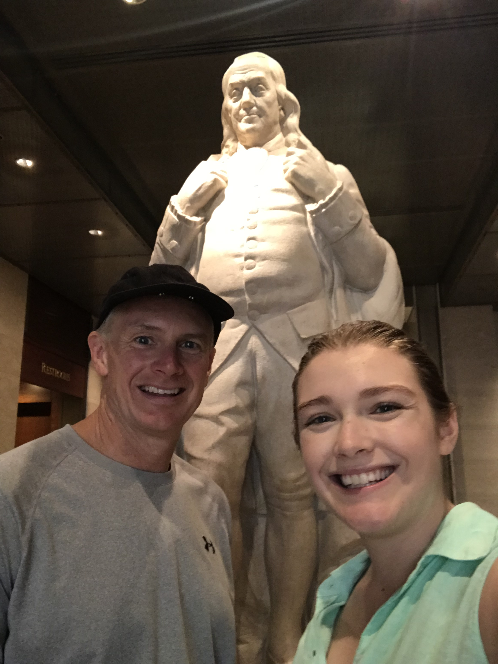
I welcome your questions.
Mark Canada, Ph.D.
Executive Vice Chancellor
Professor of English
Indiana University Kokomo
canadam@iuk.edu
markcanada.info

Slide 37
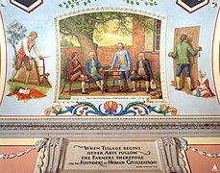
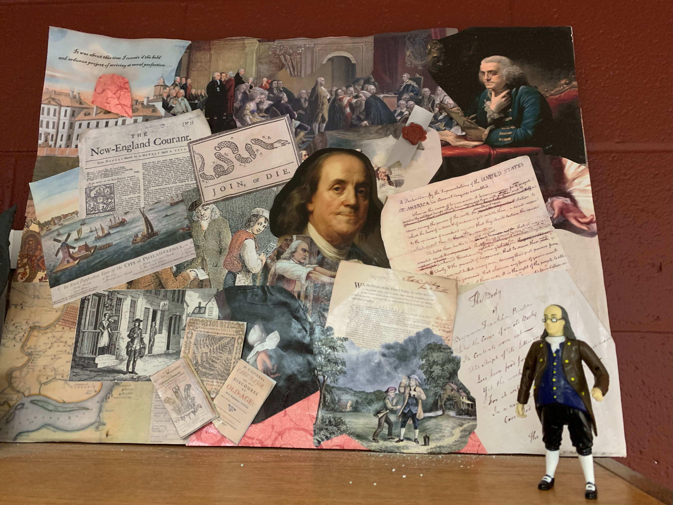
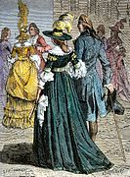
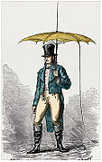
Bonus
Emile Deschamps and Yan Dargent, public domain, Wikimedia Commons
Image of umbrella with lightning rod, public domain, Wikimedia Commons
Allyn Cox, mural in Great Experiment Hall, U.S. Capitol, public domain, Wikimedia Commons

Slide 38
Franklin collage by Lisa Canada, Franklin action figure

Slide 39
For Further Exploration . . .
Books
The Autobiography
Benjamin Franklin: Writings (Library of America)
The First American: The Life and Times of Benjamin Franklin, by H.W. Brands
The Americanization of Benjamin Franklin, by Gordon Wood
Benjamin Franklin: An American Life, by Walter Isaacson
Benjamin Franklin: An Illustrated History of His Life and Times
Stealing God’s Thunder, by Philip Dray
Ben Franklin’s Lessons in Life, by Mark Canada
Web
The First American Diplomat
”Ben Franklin Lives in Your Smartphone”
“In Praise of Printing and a Favorite Franklin Typeface”
”Benjamin Franklin’s Fight Against a Deadly Virus”
“Talking Politics in 2021: Lessons on Humility and Truth-Seeking from Benjamin Franklin”
The Benjamin Franklin Tercentenary
“Benjamin Franklin’s Inventions”
Sounds of a Glass Armonica
Poor Richard’s Almanack for 1739
Manuscript of The Autobiography
Benjamin Franklin: A Documentary History
Franklin & His Friends
“Finding Franklin: A Resource Guide”
Notes:
James Surowiecki has observed. In his book The Wisdom of Crowds, Surowiecki explains, “. . . under the right circumstances, groups are remarkably intelligent, and are often smarter than the smartest people in them.” Surowiecki, The Wisdom of Crowds, xiii.
Noting that sociologists have suggested that the average person has about 300 relatively close acquaintances, Wiseman points out that each of us then typically is just once removed from some 90,000 people. That’s a lot of potential professional, romantic, and other opportunities.

Slide 40
B. Franklin, Printer
318 Market St., Philadelphia
  Education
  Grammar School, 1714-1715
  Brownell’s School, 1715-1716
  Honorary Doctorate of Laws, University of St. Andrews, 1759
  Career
    Printer
    Poor Richard’s Almanack
    Pennsylvania Gazette
    Author
    The Autobiography
    Essays: “The Speech of Miss Polly Baker,” “A Witch Trial at Mount Holly,” etc.
    Scientist and Inventor
    Electricity: kite experiment, insulators/conductors, terms (battery, plus, minus, etc.)
    Inventions: bifocals, lightning rod, Franklin stove, armonica, etc.
    Politician and Diplomat
    secured French support for the American Revolution
    contributed to the Declaration of Independence, Constitutional Convention, etc.
    Philanthropist
    First subscription library, volunteer fire company, matching grant
    Pennsylvania Academy (University of Pennsylvania), Pennsylvania Hospital
  References
  Anne-Robert-Jacques Turgot
  Thomas Jefferson
  David Hume
“harmonious human multitude”
-Carl Van Doren
“snatched lightning from the sky and the scepter from tyrants”
-Anne-Robert-Jacques Turgot
“the greatest man and ornament of the age”
-Thomas Jefferson
Notes:
As far as I know, Franklin never compiled a resume--not an expectation in the eighteenth century--but can you imagine if he did? It would look something like this . . .
Highlights
responsible for "Stealing God's Thunder" (title of book by Philip Dray)
launched the self-improvement movement
empowered the common man--and woman
inspired untold numbers of readers
signed the four most important documents of the Revolutionary Era: Declaration of Independence, Constitution, Treaty of ), (the only person to have done so)
References
Davy Crockett, who had one book with him at the Alamo: Franklin's autobiography.
Andrew Carnegie, whom Franklin inspired to give munificently to libraries.
James Montgomery Beck: “In my judgment, [Franklin] was not only the greatest intellectual genius of the eighteenth century, but shares with Plato, Leonardo Da Vinci, Michel Angelo, Francis Bacon, and William Shakespeare the supreme glory of being one of the few myriad-minded men of all time” (James M. Beck, qtd. In Huang 158).
There have been a few Americans--mind you, just a few--who have had a greater impact in one particular area than Franklin. Thomas Edison's inventions, for example, did even more than Franklin's did to change our way of life, and George Washington may have had more influence on the early success of the American political system. When it comes to impact and versatility, however, I would put Franklin up against any American, indeed anyone in the history of the world, including Leonardo da Vinci. As biographer Carl Van Doren put it, Franklin was a “harmonious human multitude.”

Slide 41
Benjamin Franklin
Scientist, Diplomat, Author—and Role Model?
Mark Canada, Ph.D.
January 22, 2022

